Slide 1
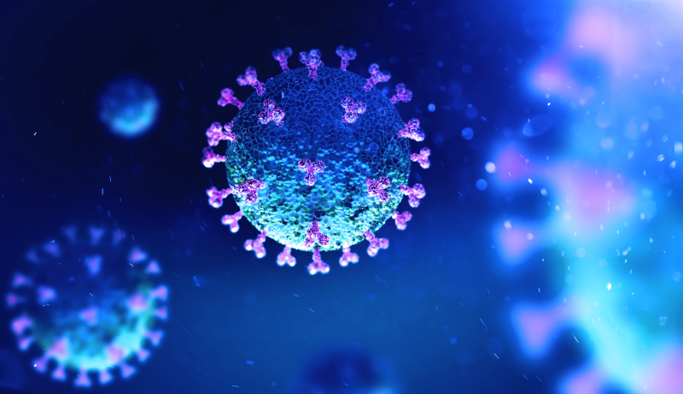
Covid-19 Detection from Pulmonary CT scans
Guide : Prof. Biplab Banerjee
Team Members :
Bachalakuri Sowmya | 180050018
Desham Sreya Reddy | 180050028
Lackarsu Siri Verma | 180050052
Vineetha Vennela | 180050118

Slide 2
Problem
The recent pandemic has seen an unprecedented rate of increasing patients and demands from hospitals for testing and diagnosis. Providing a fast, robust and accurate detection on Covid-19 during these times would play a role in reducing the panic, demand and spread of the infection. Along with prevailing medical advances, AI and deep neural networks can be used as a tool to achieve this by directly detecting the presence of COVID-19 from CT scans of the lungs.

Slide 3
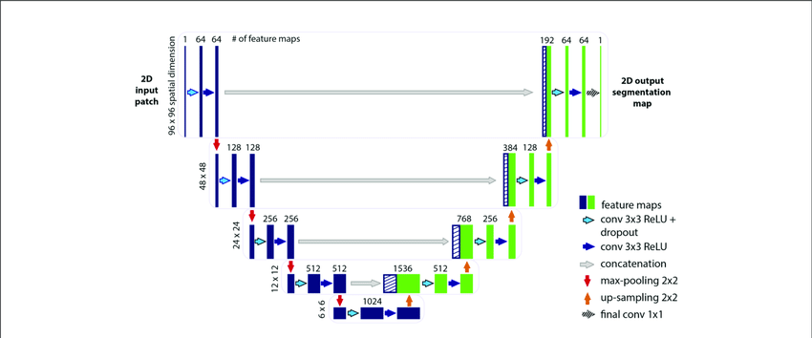
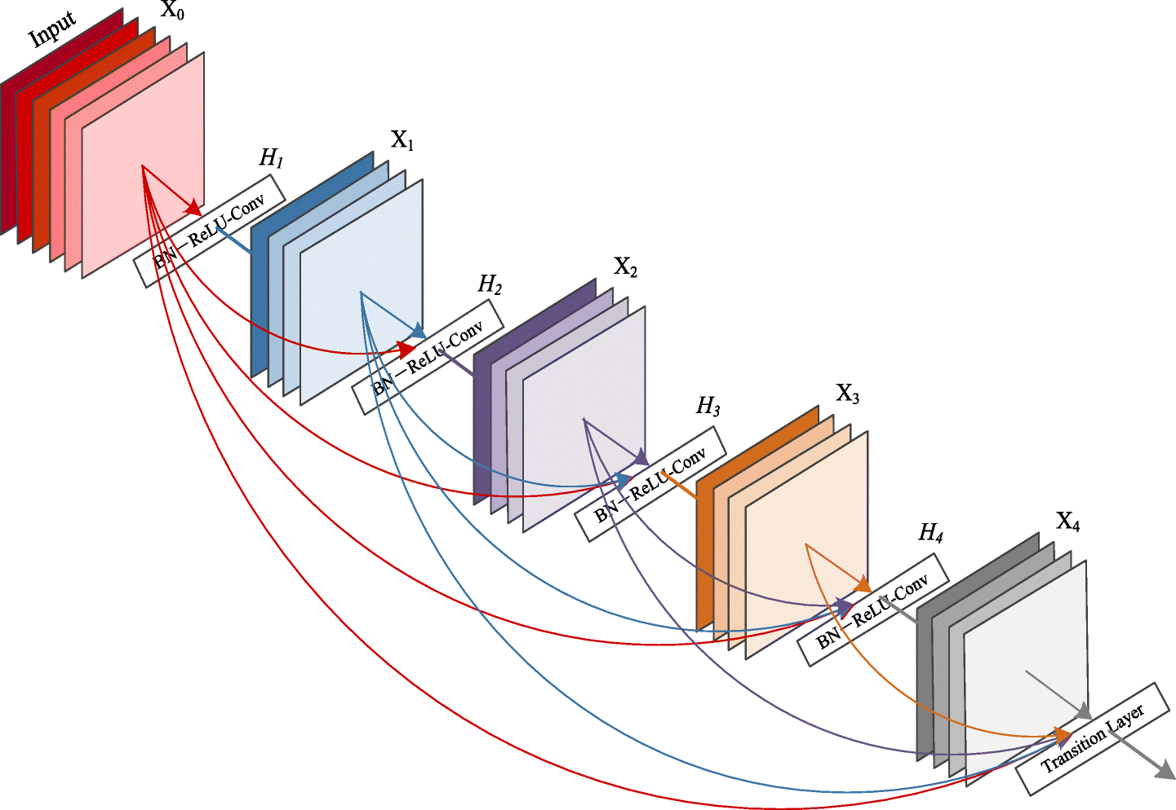
Architecture
Two steps:
Image segmentation
2. Image classification
https://www.researchgate.net/figure/Illustration-of-the-U-net-architecture-The-figure-illustrates-the-U-net-architecture_fig2_331406702
https://ai-pool.com/m/densenet-1568742493

Slide 4
Image segmentation
The provided images are preprocessed to appropriate dimensions and are normalized
A U-net model is designed for segmentation and trained using model input images, as U-net is popular in biological image segmentation [1]
Once the network is trained, train and test images are processed and the resultant images are stored in a folder, to be given to the classifier

Slide 5
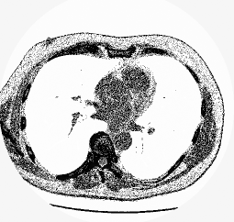
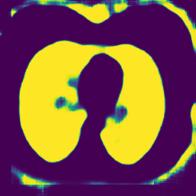
Output Visualization of segmentation
Input Image
Image after segmentation

Slide 6
Image classification
The problem is treated as binary classification with classes covid and non-covid
The resultant images from segmentation are imported, preprocessed into fixed dimensions and normalized
DenseNet121 architecture in keras, due to its greater efficiency, is pre-trained on the ImageNet database
The network is added with a Global Average Pooling layer and a dense layer at the end and trained using the preprocessed training images (with batch size 16)
Validation and training error data is collected

Slide 7
Results
Model is trained and tested on imported dataset [3]
After training the model for 100 epochs, the following results were obtained.
RESULTS | Cross-entropy loss | Accuracy | MSE loss
Training Data | 0.0094 | 0.9958 | 0.0020
Testing Data | 0.1921 | 0.9167 | 0.0644

Slide 8
References
[1] https://arxiv.org/abs/1505.04597
[2] https://pubs.rsna.org/doi/10.1148/radiol.2020200905
[3] https://www.kaggle.com/kmader/finding-lungs-in-ct-data

Slide 9
Thank You!

